Slide 1

Microsoft Data Fest 2019 Azure Solutions
Jan 2019
Tim Roberts pluralpoint - Developer, Solution Architect
Vikas Gaikwad Aspect Software Inc - Senior Manager Shared Services Solution Delivery

Slide 2
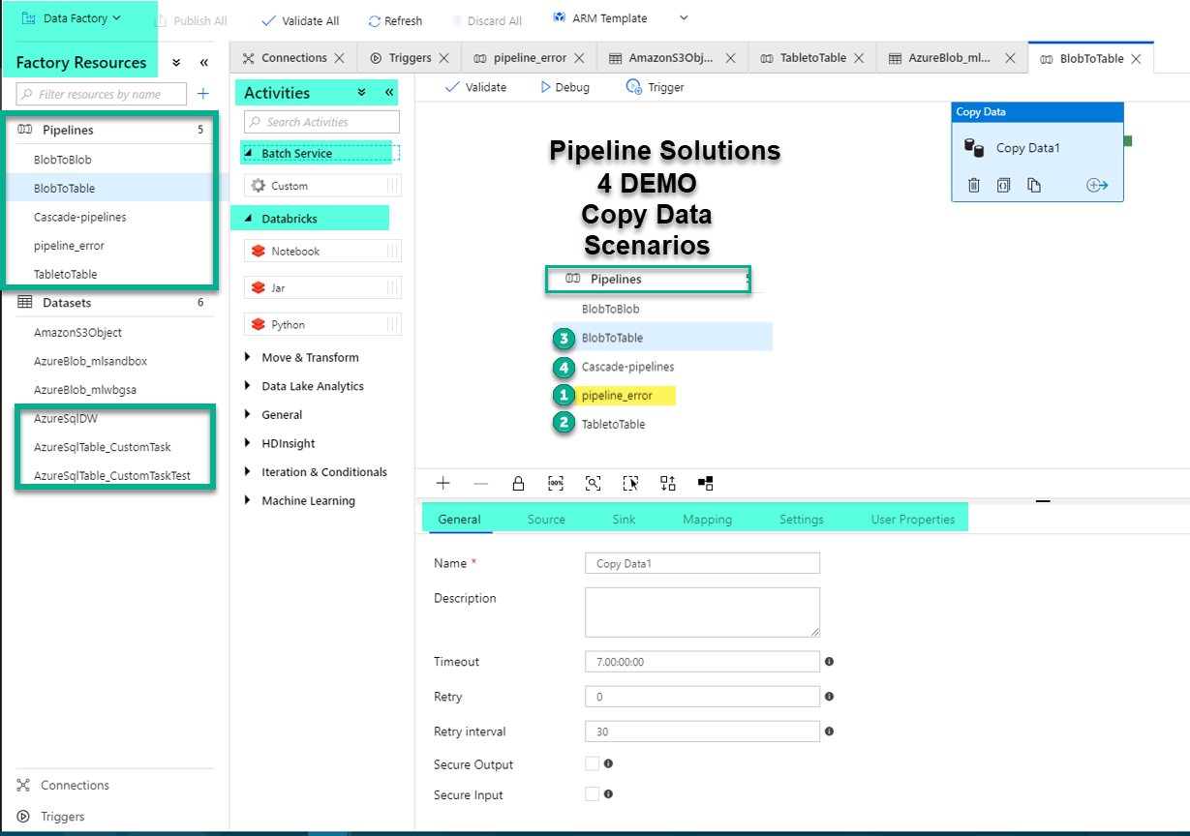
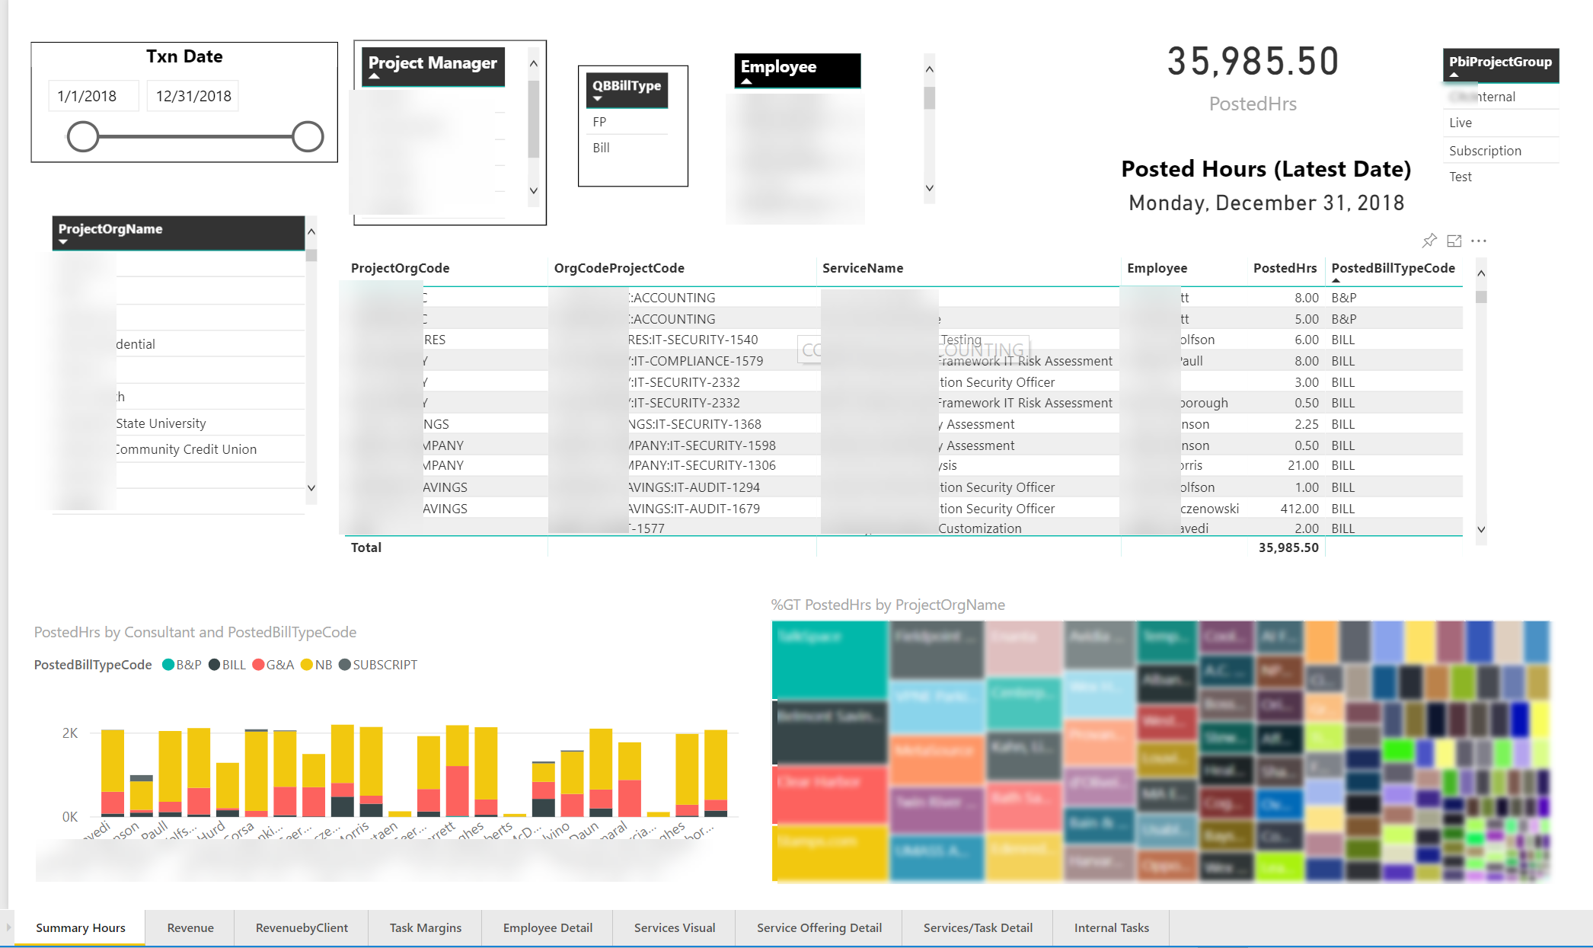
Agenda – Azure Solutions
Tim Roberts
SSIS/Power BI
Development & Azure Deployment
---------------------------------------------------------
Vikas Gaikwad
ADF Approach - Azure Data Factory Pipeline Solutions
Development & Deployment
---------------------------------------------------------
Data Engineering
Data Visualization

Slide 3
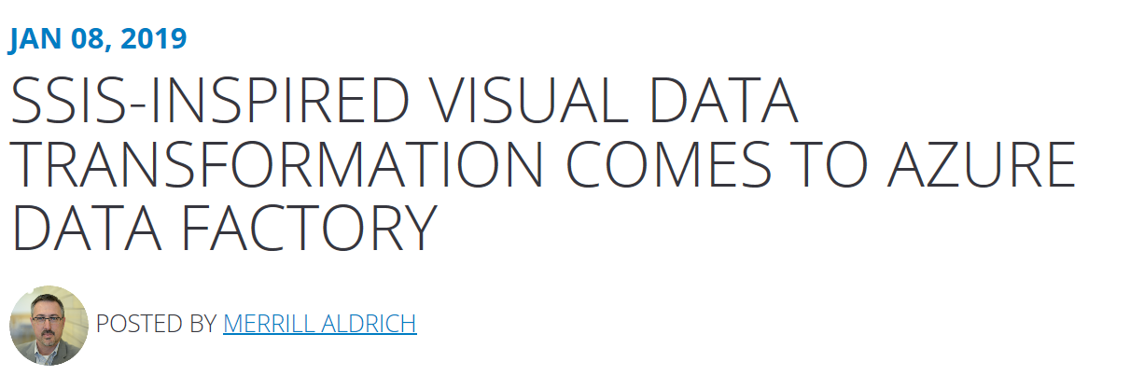




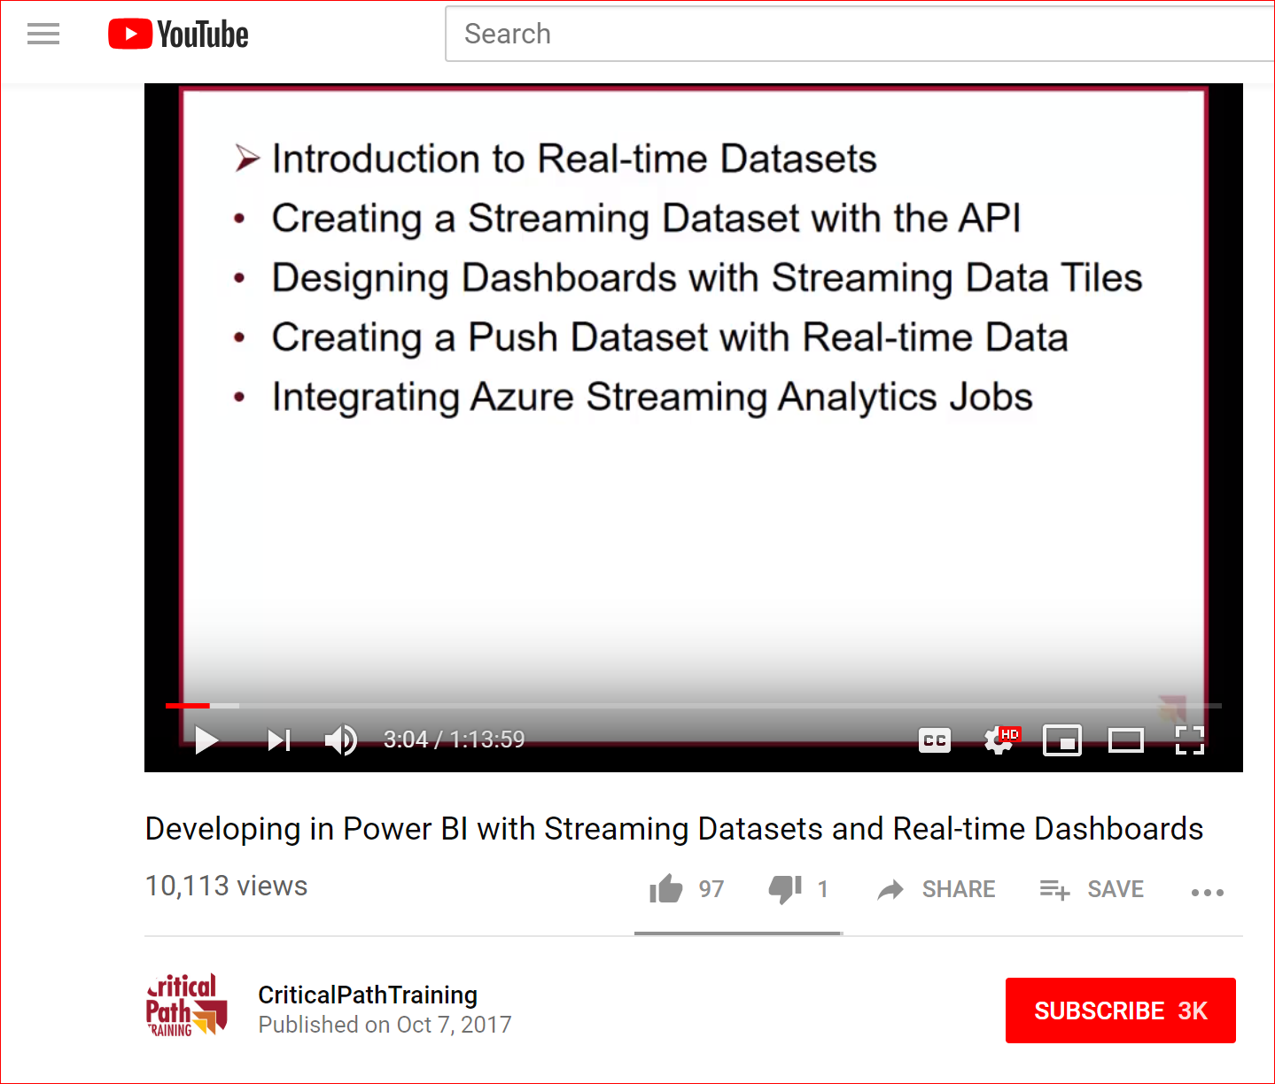
Credits & Good References
Andy Roberts
Solution Architect Microsoft Corporation
---------------------------------------------------------
https://blogs.msdn.microsoft.com/charles_sterling/2017/06/08/power-bi-streaming-datasets-hands-on-lab/
Ted Pattison, Critical Path Training https://www.youtube.com/watch?v=IPbe4BLoE_s

Slide 4
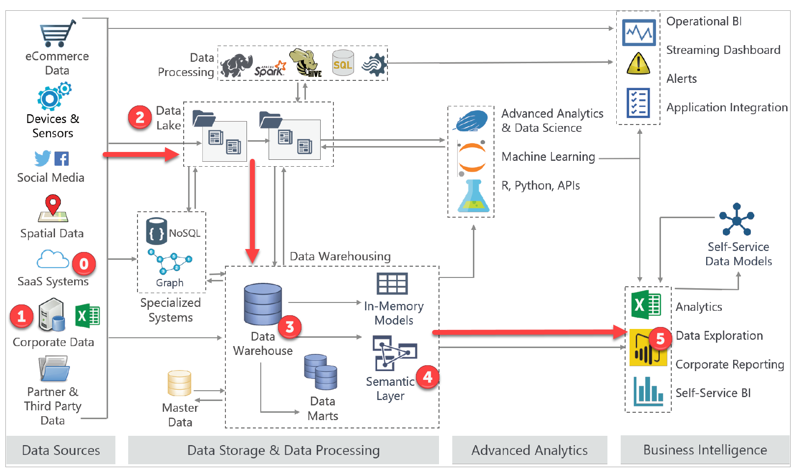
Solution Architecture
Base Diagram Courtesy of BLUEGRANITE

Slide 5
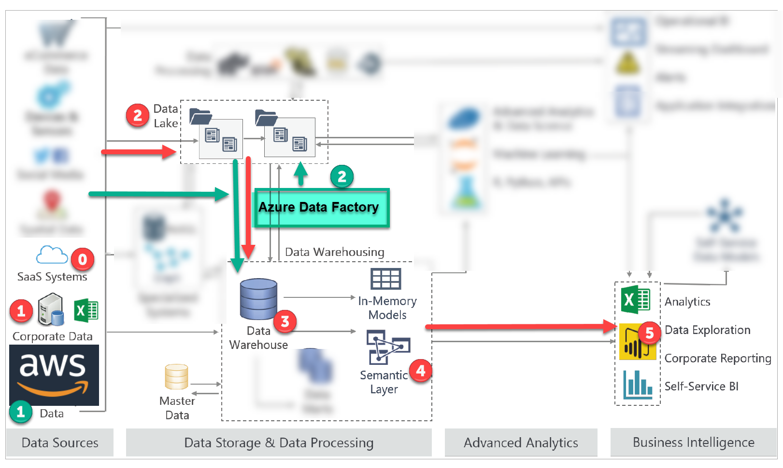
Solution Architecture SSIS and ADF
Base Diagram Courtesy of BLUEGRANITE

Slide 6
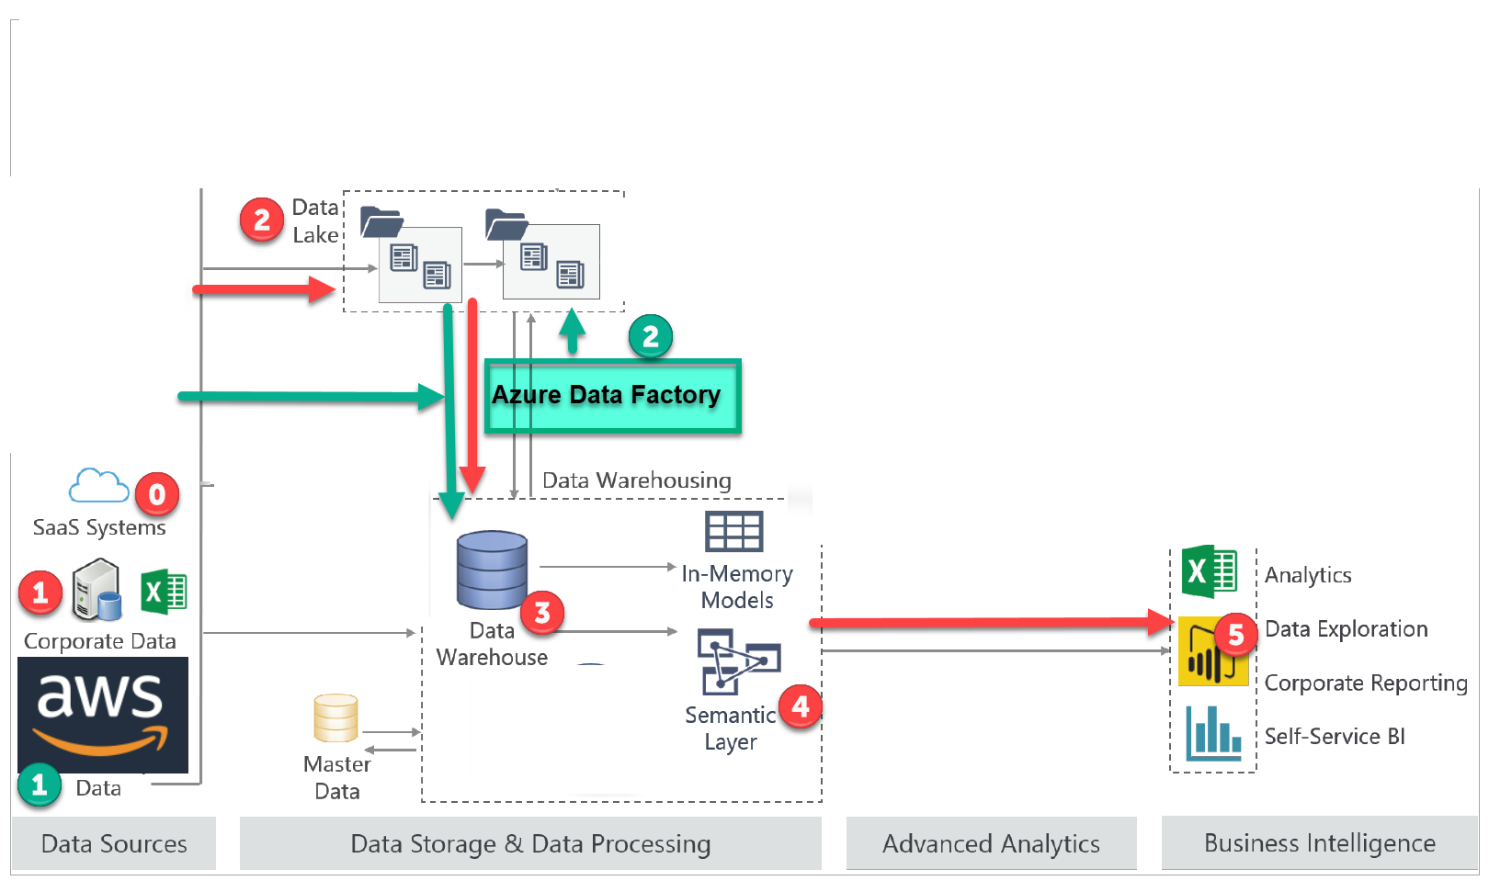
Solution Architecture SSIS & ADF Simplified
Base Diagram Courtesy of BLUEGRANITE

Slide 7
SSIS/PBI Solution Components and Highlights
Data Sources
Data Engineering
Data Visualization
QuickBooks Online SaaS
Unanet – SaaS Project Time& Costs
Client Excel Control Sheets
Effective Fully Loaded Hourly Costs for Consultants
Project Groups
Timely, predictable delivery of quality assets and processes
Scheduled extraction coordinated with Billing System and Accounting
Staging and Cleansing using SSIS, POSH regex, and SISS workflow
“Lights Out” extraction interface thru Java Jar files called from PowerShell (POSH)
Flow Triggers from email listener
Azure Power BI Pro (PBI) E5
Integrated control files
Effective Fully Loaded Hourly Consultant Costs
Project Groups of Interest
Key Considerations
Filtering, Drill Down
User and Developer Training
Client to Extend Dashboard Visualizations

Slide 8
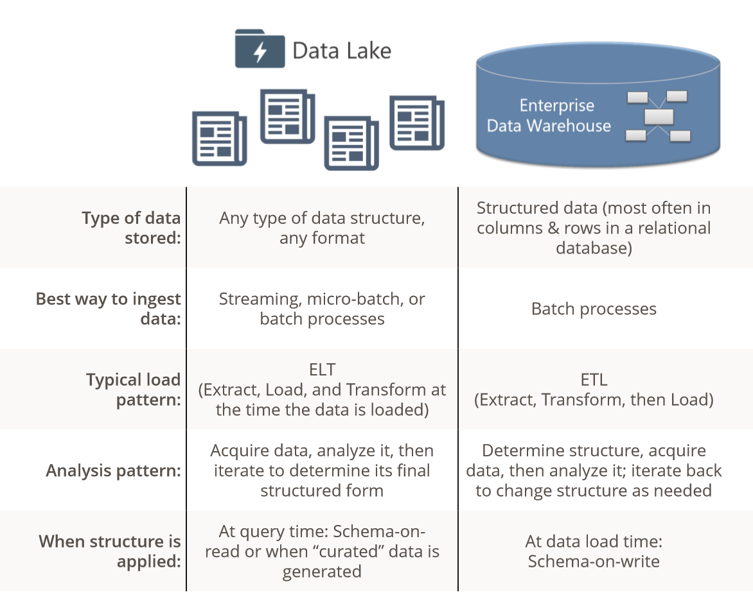
Data Lake – Data Warehouse Approaches
Courtesy of BLUEGRANITE

Slide 9
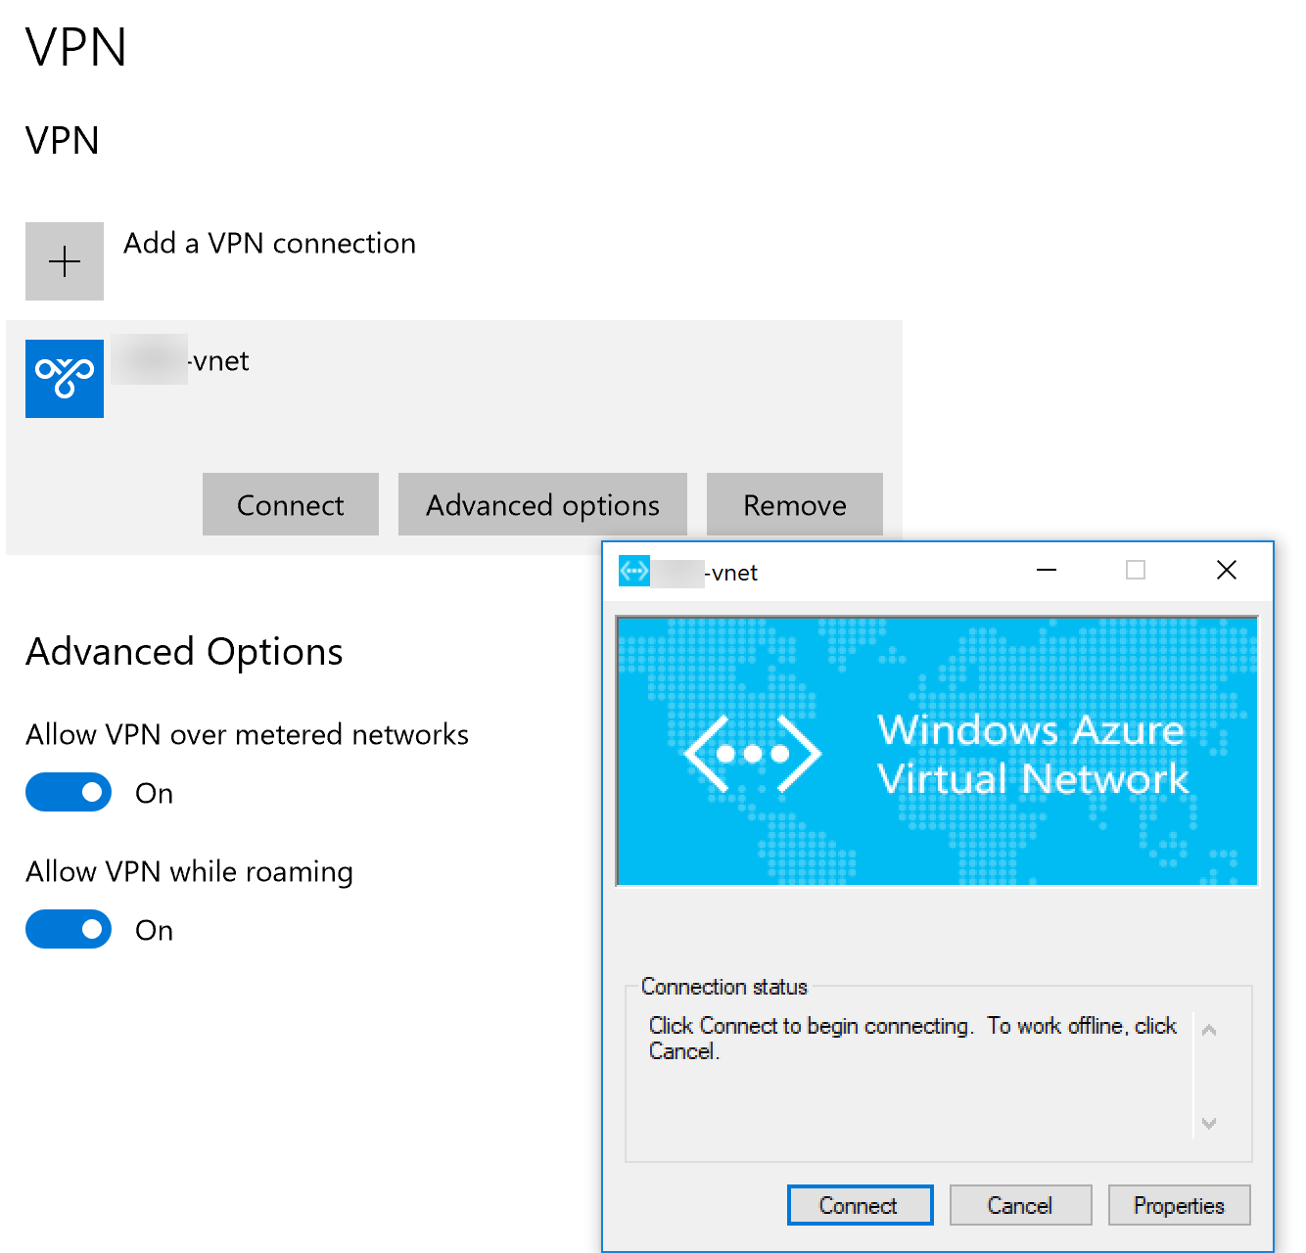
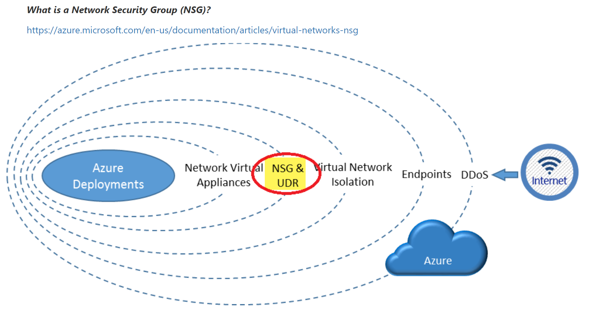
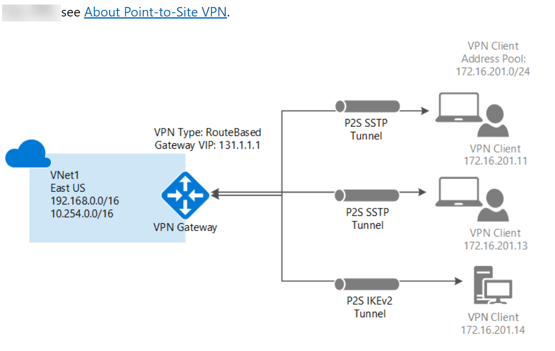
Secure the VMs and VNet Developer Client - Azure P2S VPN and NSG (Network Security Group)
Windows 10 Client
https://docs.microsoft.com/en-us/azure/vpn-gateway/vpn-gateway-howto-point-to-site-resource-manager-portal

Slide 10
Data Engineering
SSIS/PBI Solution
Data Visualization

Slide 11
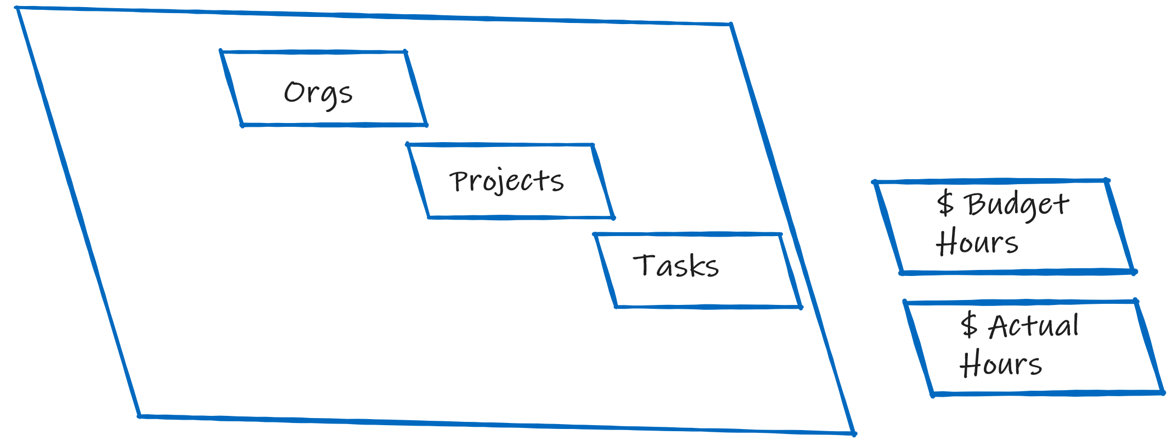
Revenue, Cost, Margins, Variance (Budget vs Actual) by Client (Orgs), Project & Task, Phases, by Date, Consultant, Service Offerings

Slide 12
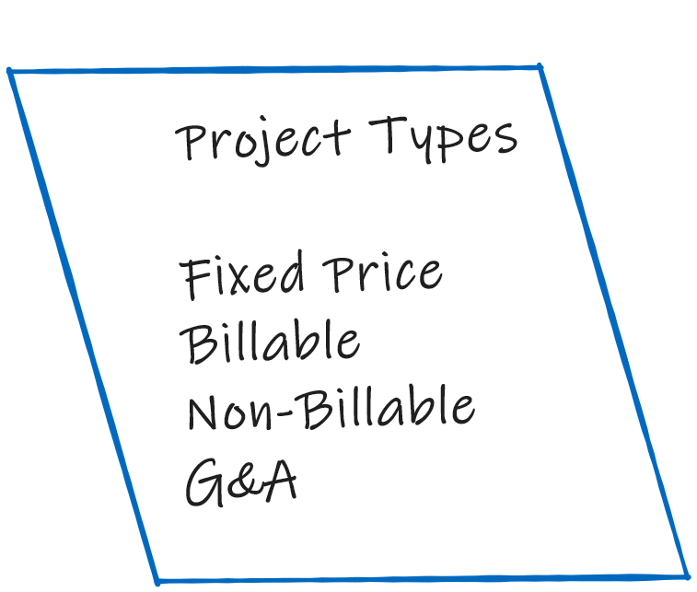


Project Types

Slide 13

Project Completion Detail
Phases
Percent Complete

Slide 14
Assignments
Assignments
Phases
Percent Complete

Slide 15
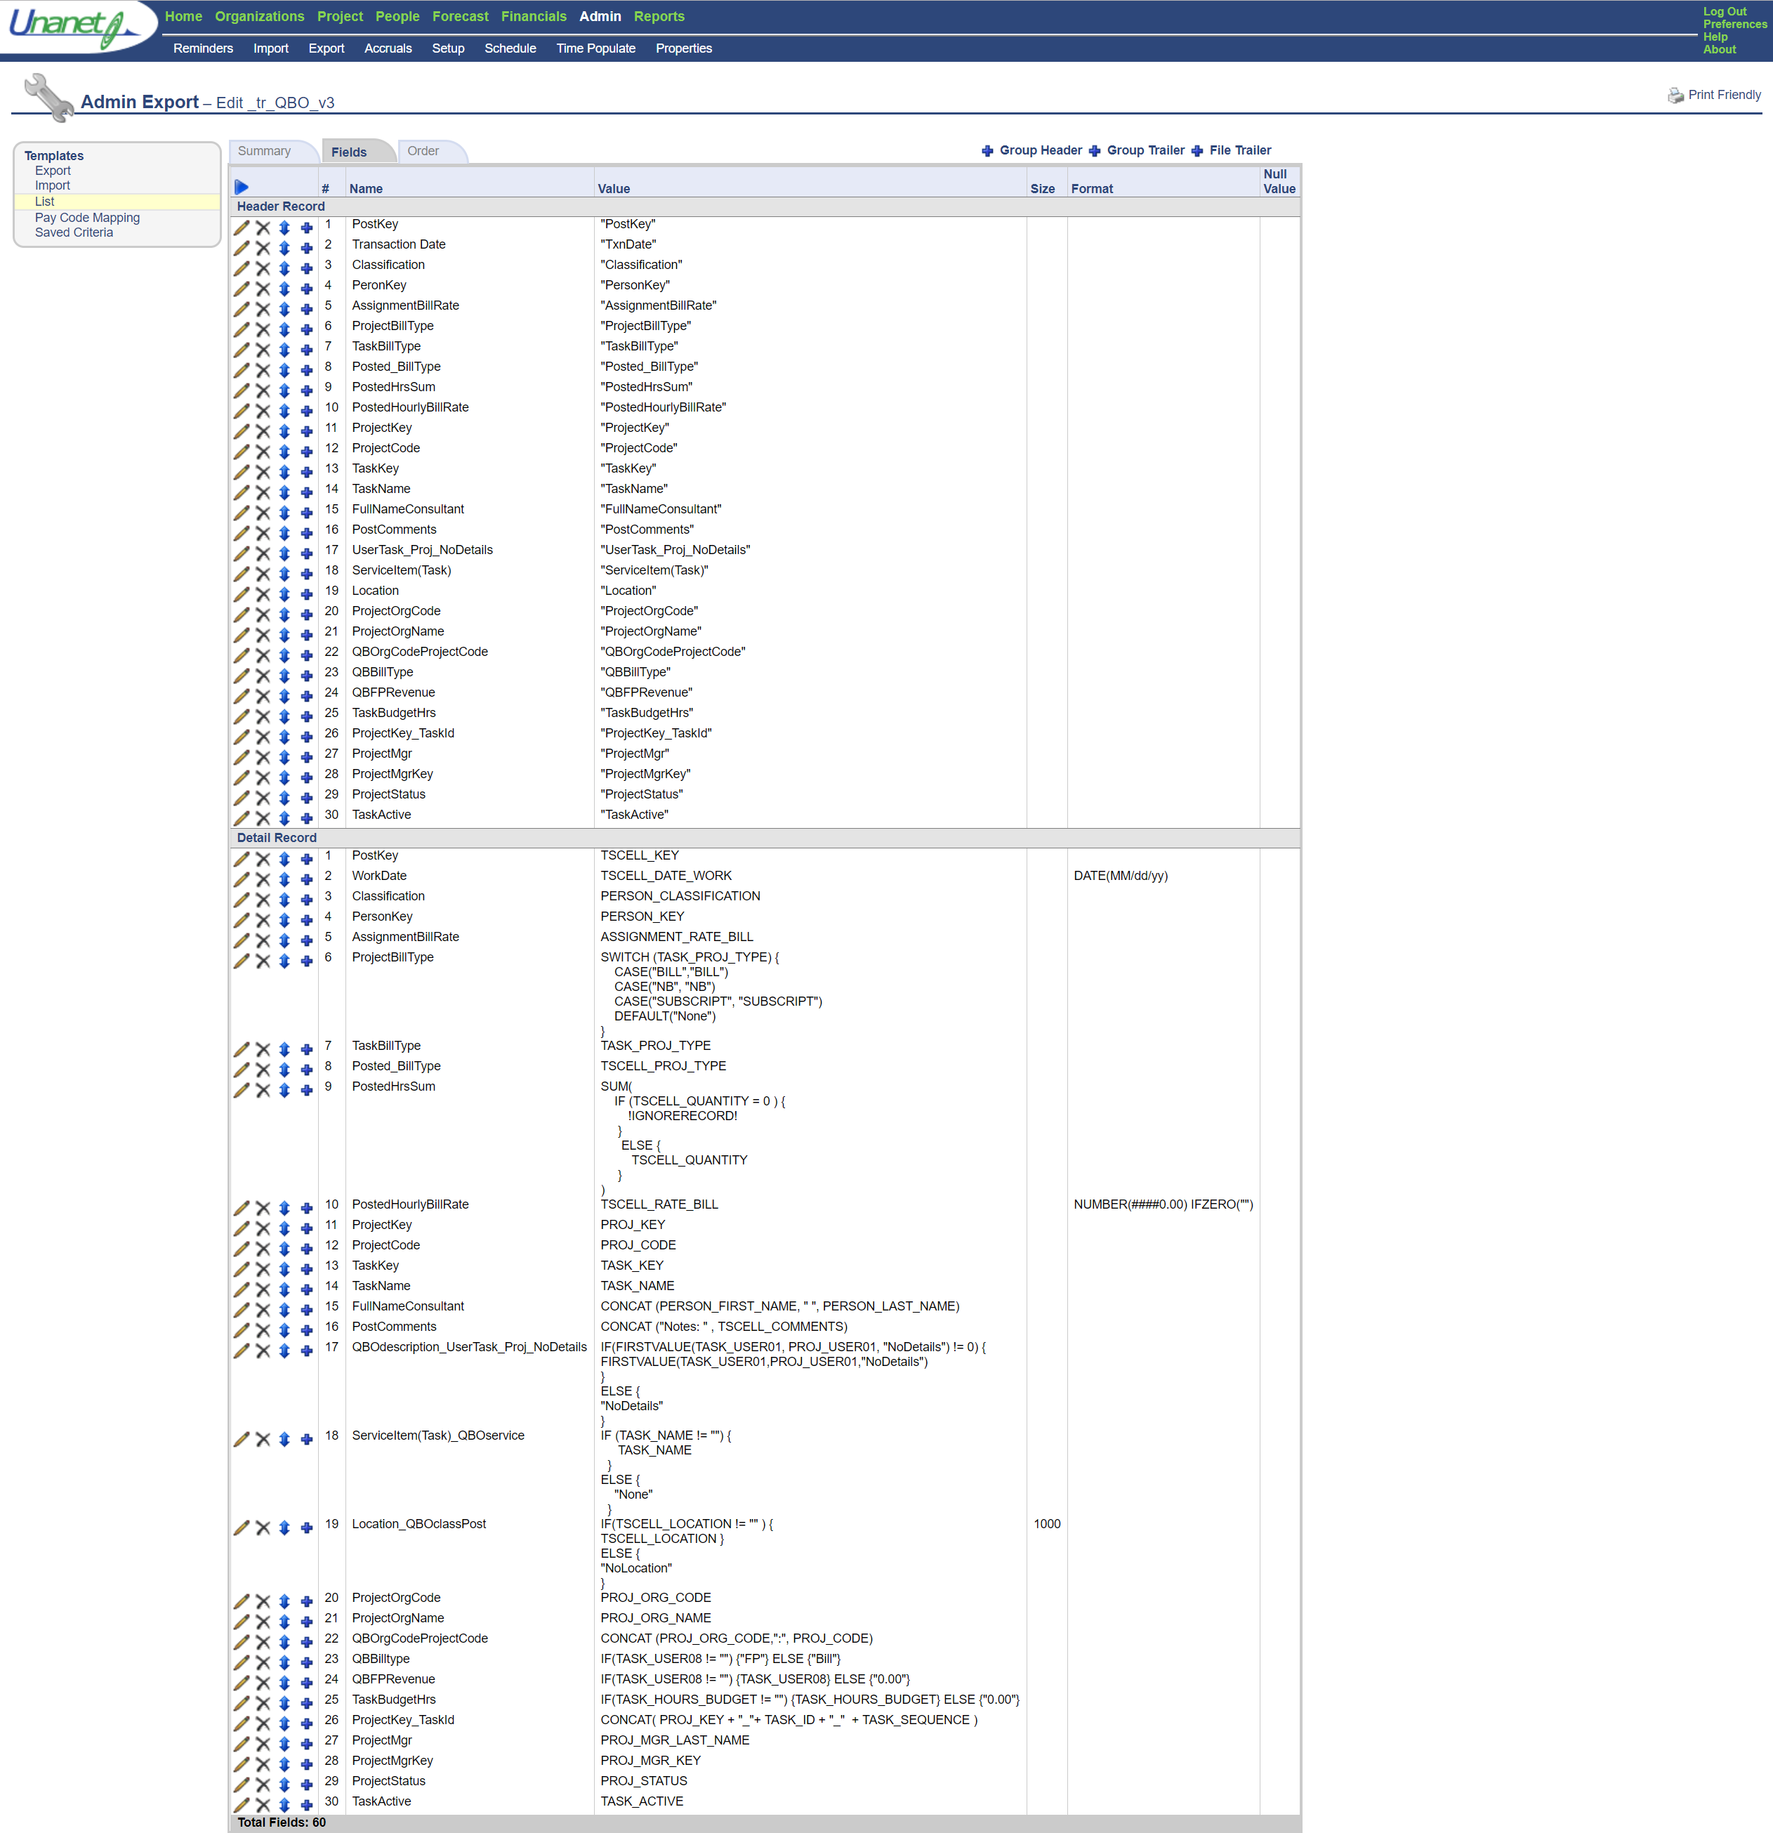
Source Data Extract - Time & Cost, etc.

Slide 16
SSIS/PBI DEMO

Slide 17
Azure Data Factory Pipeline Solutions

Slide 18
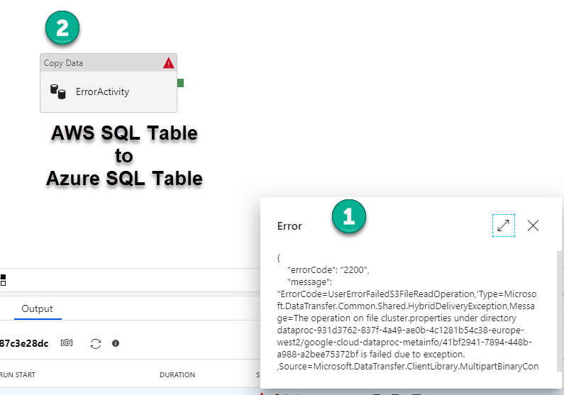
Azure Data Factory Pipeline Solutions Error Handling and Debug

Slide 19
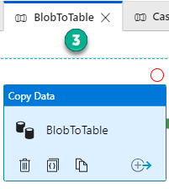
Azure Data Factory Pipeline Solutions Blob to Table

Slide 20
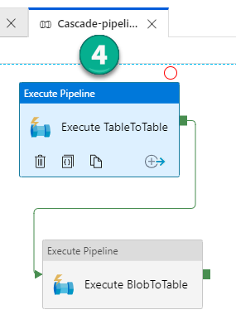
Azure Data Factory Pipeline Solutions Cascade Pipelines

Slide 21
Azure Data Factory Pipeline Solutions DEMO

Slide 22
General Q & A Thank You timrobertsusa@pluralpoint.com vikas.gaikwad@aspect.com

